Slide 1



South Dakota Army National Guard Service Member Family Support
Veteran Service Officers 2025
SERVING
SERVICE MEMBERS
VETERANS
SURVIVORS
AND THEIR FAMILIES

Slide 2



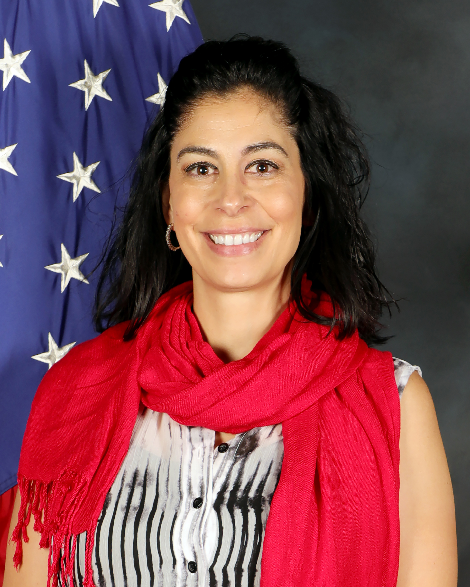
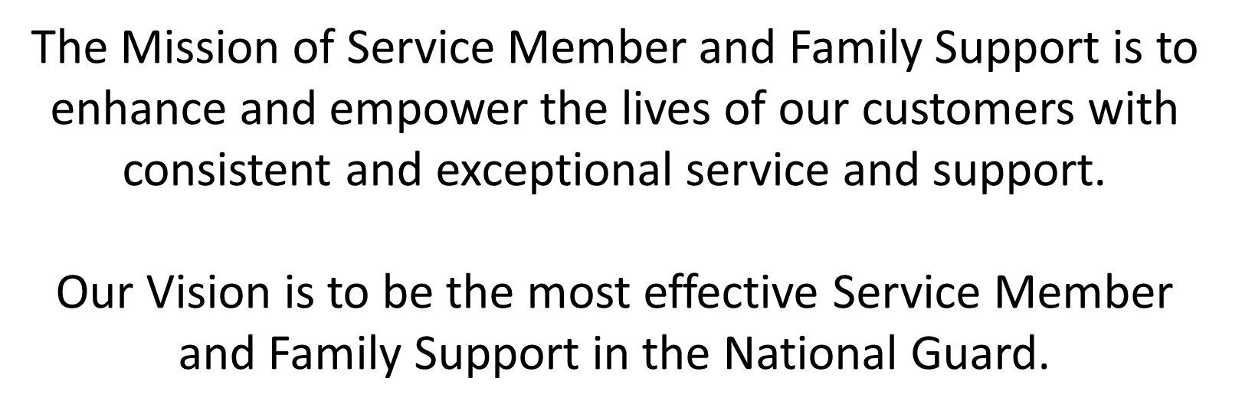
Soldier & Family Readiness Specialists
ADVISE - SUPPORT- REPORT
Michele Anderson
Lead Soldier and Family Readiness Specialist
W: 605-737-6975
C: 605-415-0471
michele.m.anderson.civ@army.mil

Slide 3
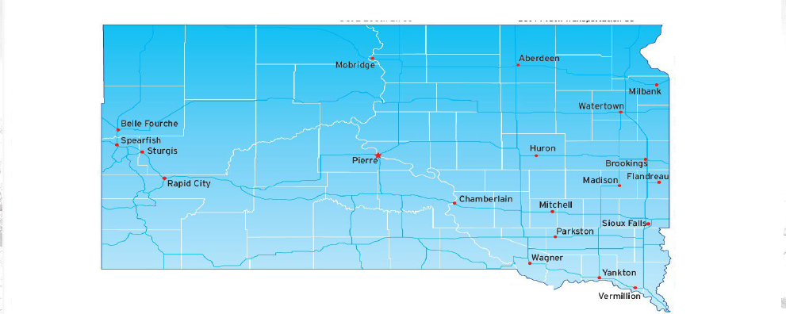
Army National Guard
Service Member & Family Support
The SDARNG is made up of 1 JFHQ, 4 MACOMS, 10 Battalions and 47 Down Trace Units disbursed throughout 20 communities.
Currently the SDARNG Family Programs supports 3,003 Soldiers and 6,099 Family Members across the state.

Slide 4
Family Assistance Center
Eight Essential Services
Crisis Intervention and Referral
Providing assistance with the following
Danger to Self and Others
Child Abuse/Neglect
Domestic Abuse
Abuse/Neglect of a Vulnerable Adult
Legal Resources and Referral
Information on Power of Attorney/Wills
Assistance with Service Members Civil Relief Act
Referrals for ESGR
Financial Resources and Referral
Understanding Military Pay
Help with Financial education, financial assistance
TRICARE Resources and Referral
Provide general information on benefits
Assist with TRICARE applications
Assist with writing appeal letters
ID Cards and DEERS
Provide information on DEERS Rapids Center
Assist with obtaining an ID Card
Community Information and Outreach
Provide array of local Community resources:
Assist with Child Care resources and referral
Assist with referral to local financial resources
Help find a local Family Readiness Group
Exceptional Family Member Program
Connect with ARNG EFMP Program
Assist with EFMP application & loan applications
Emergency Family Assistance Center
In a State emergency:
Provide information, referral & outreach services
Help Families regain normalcy & meet needs
Minimize impact of the event

Slide 5

TRICARE
TRICARE is the uniformed services health care program for active-duty service members, active-duty family members, National Guard and Reserve members and their family members, retirees and retiree family members, survivors, and certain former spouses worldwide.
JUDY ZIMBELMAN
Helpful TRICARE information:​ https://www.Tricare.mil​
https://www.tricare.mil/west

Slide 6

TRICARE - USERS
TRICARE is changed contracts from HealthNet to TriWest!
Visit www.tricare.mil/west for information on TriWest’s secure portal

Slide 7
ID Cards & DEERS
DEERS: Defense Enrollment Eligibility Reporting System​
Provides Information on:​
*ID Card eligibility​
*Update and verify DEERS data​
Assist with establishing DEERS appointments​
Authenticates eligibility for access and benefits
JUDY ZIMBELMAN
Online ID Card information, DEERS office locations, and appointment scheduling:​
​
https://idco.dmdc.osd.mil/idco/

Slide 8
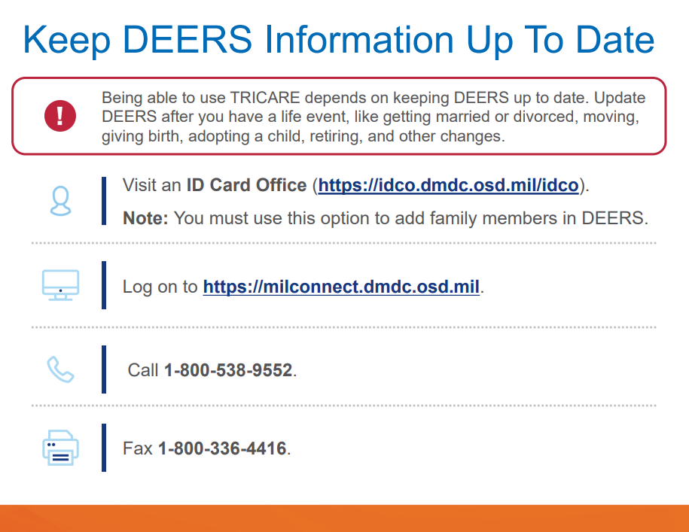

Slide 9


Slide 10










Notes:
• Once enrolled in the EFMP, family member remains in the program until:
– The condition that warranted enrollment has been resolved.
– The Service member leaves the Army.
– The Family member is no longer enrolled in DEERS.
• Documentation is required to disenroll from the EFMP regardless of the
circumstances and this documentation must be requested through the either the
medical provider for a medical enrollment or the school/early intervention provider
for an educational enrollment.

Slide 11

Soldier & Family Readiness Specialist Team
Bill Flippo
Ruth Ragels
Address: 300 5th Street S. Brookings, SD 57006
Address: 5501 Airport Rd.
Office Phone:
Mitchell, SD 57301
Office Phone:
605-969-5416
605-995-1682
Cell Phone:
605-415-1013
Cell Phone:
605-877-2517
Email:
^{Bill.M.Flippo.civ@army.mil}
Email:
ruth.e.ragels.civ@army.mil
Michele Anderson Lead
Address: 2823 W. Main Street Rapid City, SD 57702
Office Phone:
605-737-6975
Cell Phone:
605-415-0471
Email:
michele.m.anderson.civ@army.mil
Priscilla Harkin
Paul Mausbach
Address: 801 W. National Guard Dr.
Sioux Falls, SD 57104
Office Phone:
605-357-2942
Cell Phone:
605-415-2481
Email:
paul.g.mausbach.civ@army.mil
Address: 801 W. National Guard Dr.
Sioux Falls, SD 57104
Office Phone:
605-357-2983
Cell Phone:
605-787-3313
Email:
priscilla.h.harkin.civ@army.mil
Vacant
Jay Schreiber
Address: 2823 W. Main Street
Rapid City, SD
Office Phone:
605-737-6079
Cell Phone:
605-786-8352
Email: john.w.schreiber2.civ@army.mil
Address: 2823 West Main Street
Rapid City, SD 57702
Office Phone:
605-
Cell Phone:
605-
Email:
For urgent matters after hours 1-800-658-3930

Slide 12

Any Questions?
1.800.658.3930
Michele Anderson
Lead Soldier and Family Readiness Specialist
W: 605-737-6975
C: 605-415-0471
michele.m.anderson.civ@army.mil
South Dakota National Guard
Service Member and Family Support
2823 W. Main St, Rapid City SD 57702

